Slide 1
On the Feasibility of Wi-Fi Based Material Sensing
CSE891 | Research Paper Presentation
CSE891|Research Paper Presentation
Written by:
Diana Zhang, Carnegie Mellon University
Jingxian Wang, Carnegie Mellon University
Junsu Jang, Massachusetts Institute of Technology
Junbo Zhang, Carnegie Mellon University
Swarun Kumar, Carnegie Mellon University
Presenting by:
Varuntej Kodandapuram

Slide 2
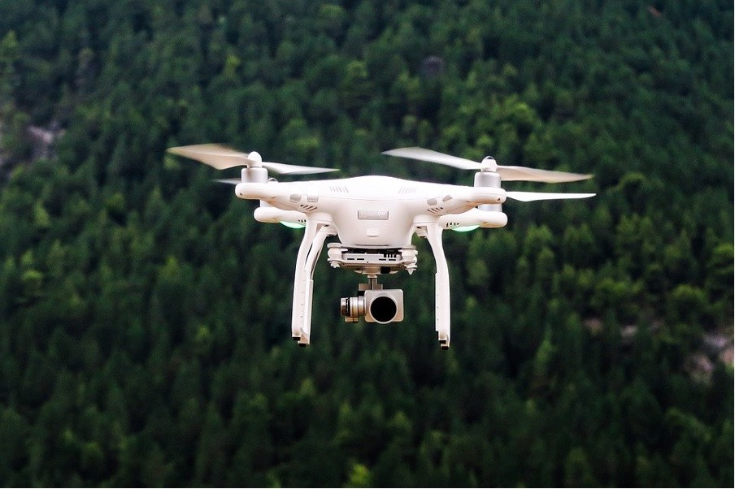

Introduction
CSE891 | On the Feasibility of Wi-Fi Based Material Sensing
Nowadays drones are seen everywhere and are used in various sectors.
Drones are UAV’s which means they are remote accessed so, everything is in the control of the user who has the remote.
So, these researchers came up with a sensing system called IntuWition which identifies the objects around the drone.
The question this paper is going to address is Can commodity Wi-Fi radios detect both the location and type of moving objects around them?”
A solution to this question is very important because if a drone is flying in a disaster site its duty is to identify survivors and and send the location to the rescue team and if the drone is unable to sense the difference between the objects and a human being then it would cost a life.
Notes:
and the user has very limited visibility while flying the drone and the user doesn’t know which materials are around the drone and the user is also unaware of any other moving objects around the drone is a major problem in almost all UAV’s.
Let's take another example to understand the importance of this solution even better nowadays drones are being used for delivery purposes like delivering medicines, packages etc.… its duty is to identify the location and land the package safely in front of the address but if its not able to identify the obstacles like children playing or a car parked or even a tree in front of the house while placing the package on ground then the drone would be destroyed along with the package. In order to eliminate such tragedies from happening the researchers came up with an innovative solution.

Slide 3
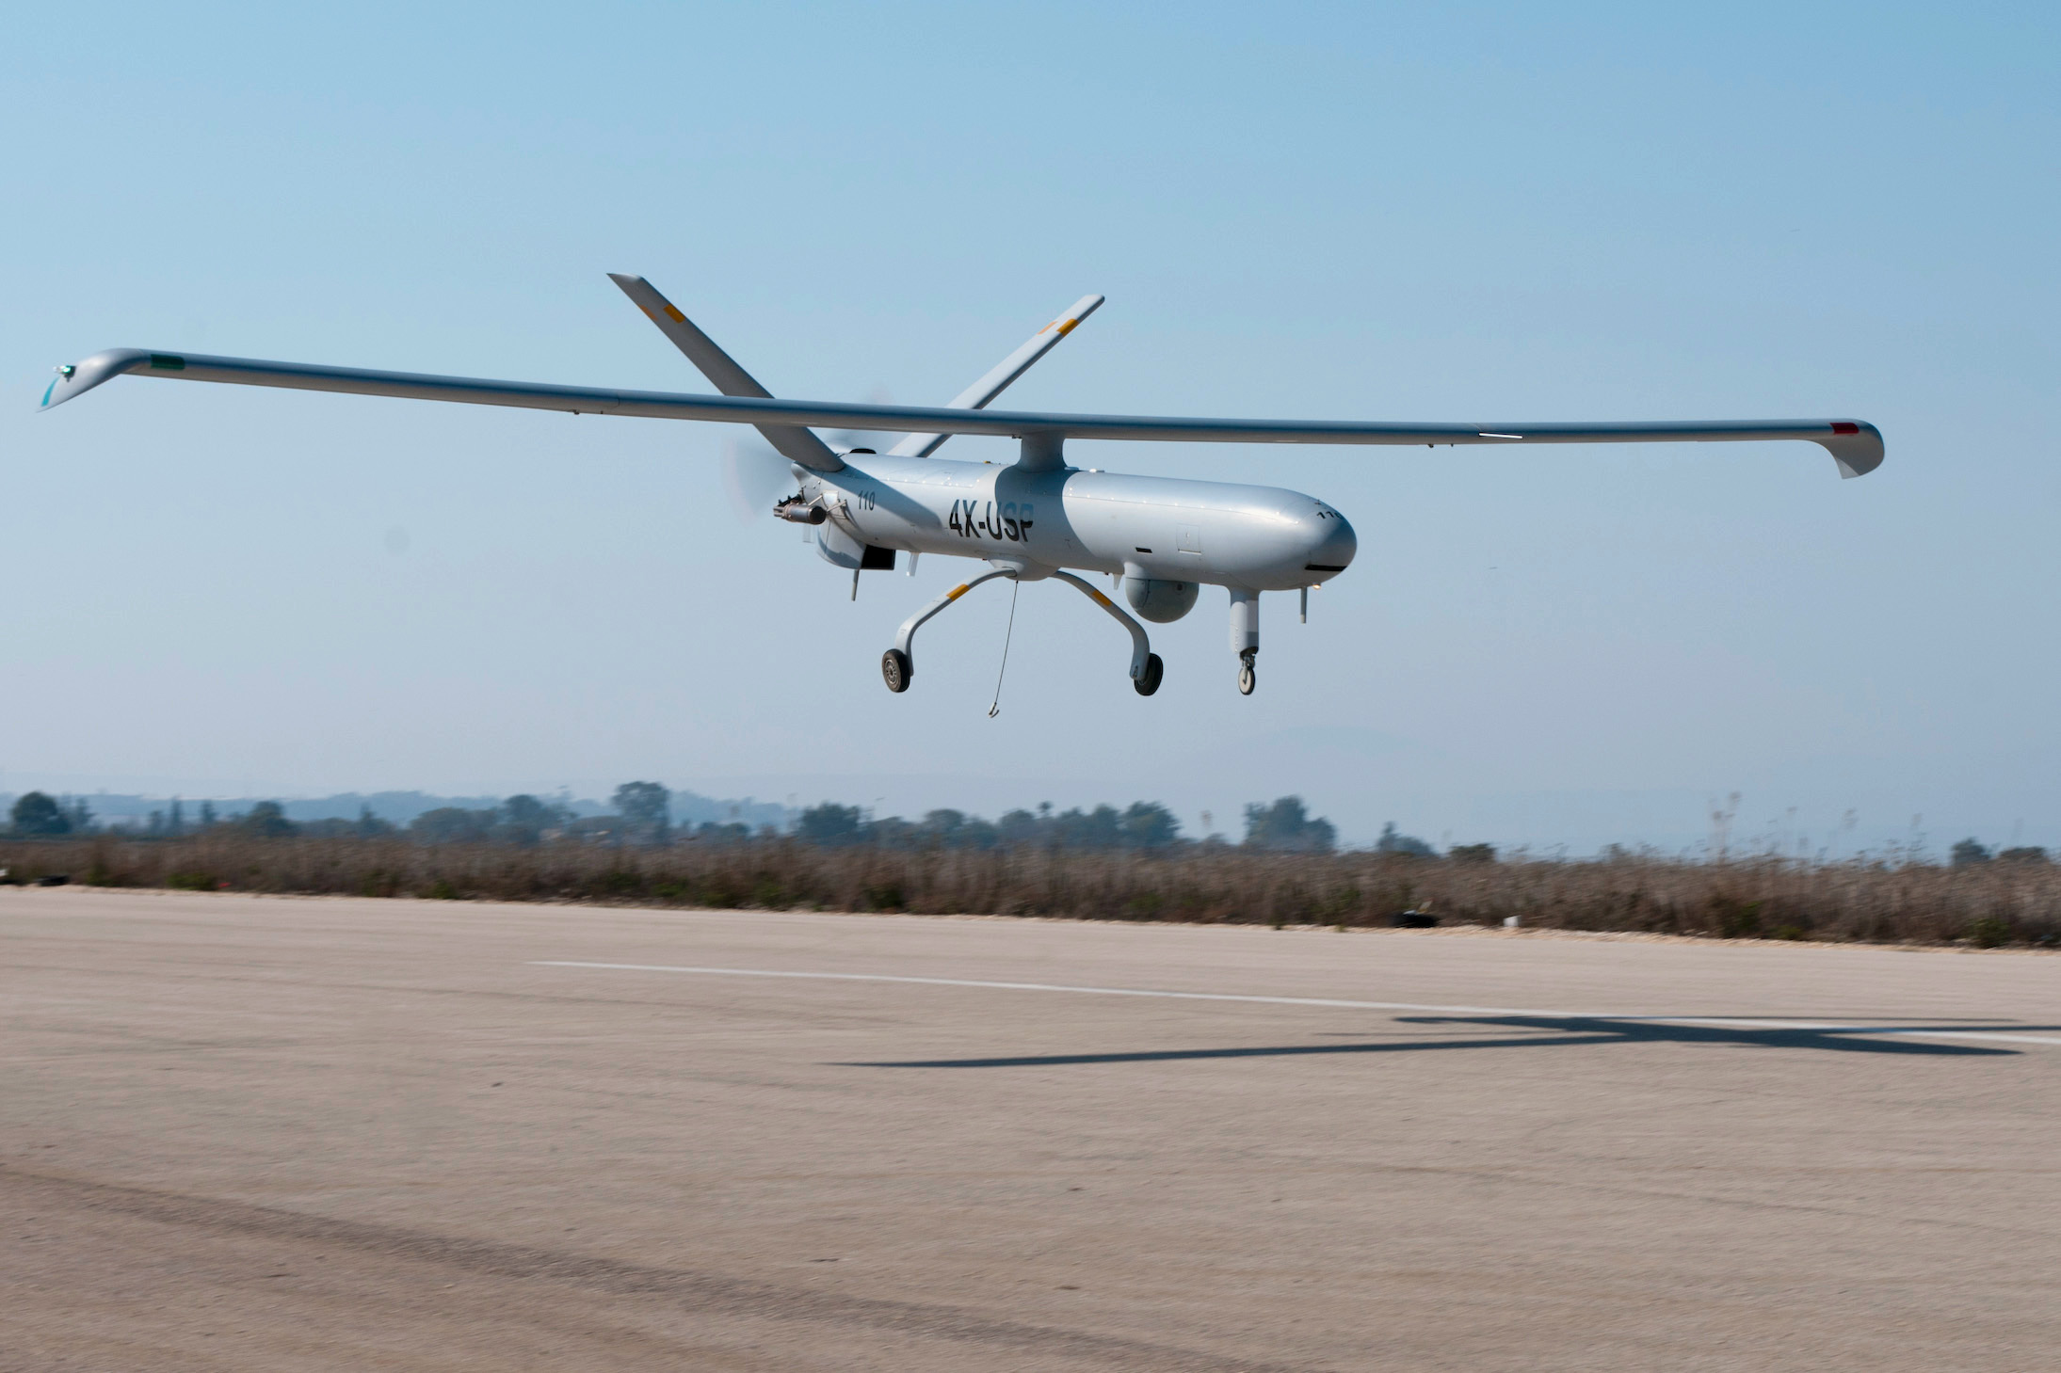
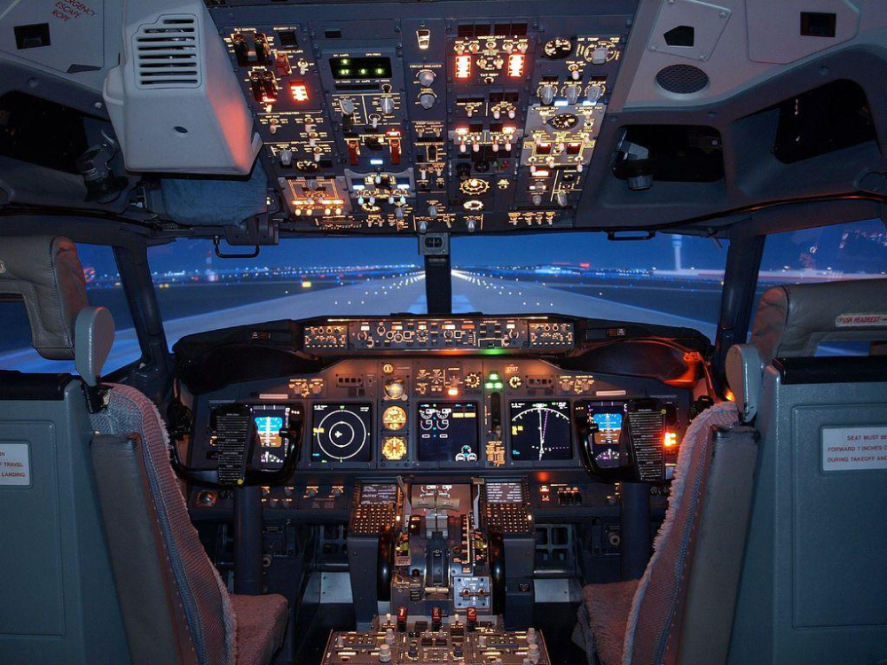
Background
CSE891 | On the Feasibility of Wi-Fi Based Material Sensing
In recent times the world’s military is moving more towards unmanned aerial vehicles as a result there have been a lot of researches that are going on in the field of wireless sensing and still, they couldn’t come up with a system that can accurately sense the composition of the material around the UAVs.
You could think that drones are equipped with cameras, and they could be used for navigation, but cameras only show objects that are in the line of sight and what about that are in non line of sight.
Then what about the RADAR system that are used in aircrafts we cannot use them because they are huge, expensive and they are not portable.
Notes:
1. There are new innovation in the radar systems for higher resolution and frequencies but still we can’t use them because due to the innovation the ability to propagate the signals to and from the material is reduced and consumes almost six times that of a Wi-Fi router.
2. because if it’s a human it would leave larger room of space when flying around it and if it’s a drone it would adjust its height accordingly.

Slide 4
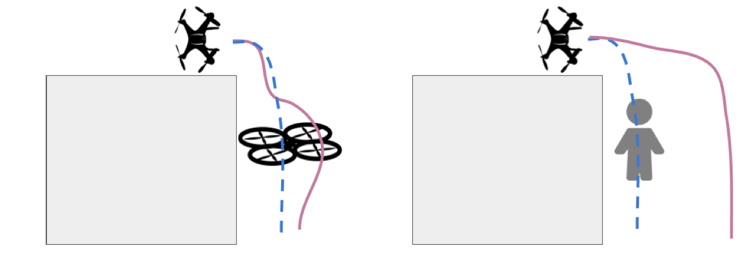
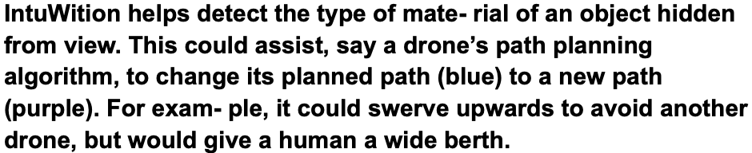
CSE891 | On the Feasibility of Wi-Fi Based Material Sensing
”IntuWition” which uses commodity Wi-fi to track objects around the drones.
Wi-fi based sensing system is being used because wi-fi signals can penetrate through obstacles like walls and this sensing system will use already existing Wi-Fi radios on the drone.
The researchers chose this type of sensing system because it can be used to detect location and classification of the material.

Slide 5

Challenges
CSE891 | On the Feasibility of Wi-Fi Based Material Sensing
There are few challenges faced by this model:
It faces difficulty in detecting objects when the receiver receives weak signal from the object.
Identifying unique feature in materials in order to classify them is another obstacle that this system might encounter.
Another major challenge this model faces is tracking objects that move with time.
The most important risk that this model might face is separating the signal paths from various objects surrounding the mobile device.
Notes:
1. For example, consider two people walking and their trajectories intersect now the model analyses the location co-ordinates but only for one person since both are in the same location.

Slide 6
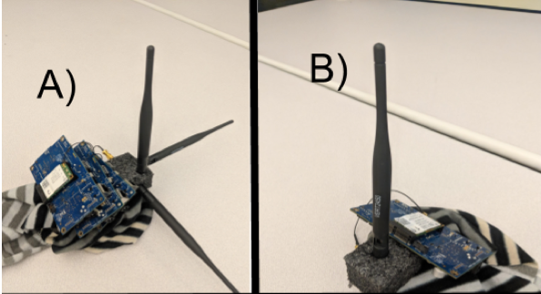
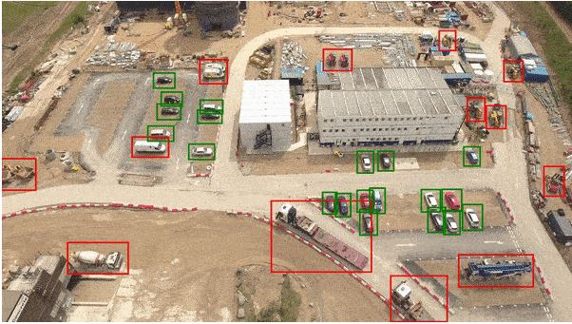
Design Details
CSE891 | On the Feasibility of Wi-Fi Based Material Sensing
The drones consists of four Wi- Fi radios – a transmitting device broadcasts packets from a vertically polarized antenna to the object, three receiving light-weight Wi-Fi chips, each with a mutually perpendicularly polarized receiver antenna on port one.
IntuWition consists of two major parts :
Localization: The model transmits the signal to the objects near it and analyses their location co-ordinates.
Material Sensing: This part uses polarimetry to analyze the material of the object. The process is shown in the following steps:

Slide 7
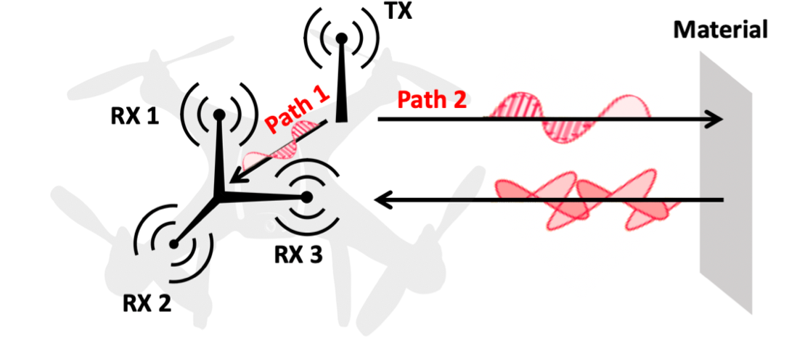
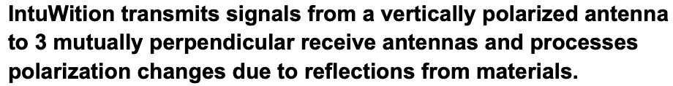
CSE891 | On the Feasibility of Wi-Fi Based Material Sensing
First step: The transmitter sends a vertically polarized signal to the objects nearby.
Second step: The signal contacts the reflector which is the object and rotates the polarized signal by a certain angle (the angle change depends on the material of the object).
Third step: Then after the angle change the signal is reflected to the receiver on the drone
Fourth step: After receiving these signals depending on the angle, the material is classified.
Notes:
1. If there are multiple signals coming at a same time to the Wi-Fi receiver, then they are separated spatially according to the time of flight with the help of localization.

Slide 8
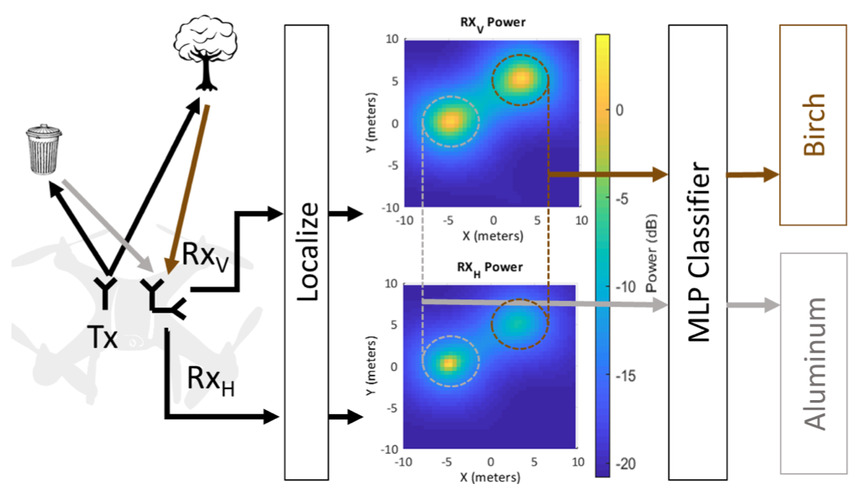
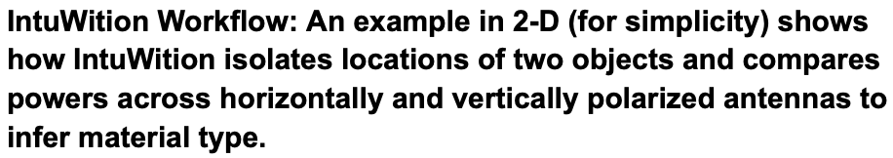
Algorithm Details
CSE891 | On the Feasibility of Wi-Fi Based Material Sensing
IntuWition uses its object localization algorithm that filters the wireless channel from an object of interest.
The researchers used a greedy algorithm to rank features according to number of successful measurements .
IntuWition employs Multi-Layer Perceptron's to train its classifier based on a theoretical analysis and an empirical comparison.
So, the researchers constructed two versions of MLP's which take raw features as input and outputs either the class of the material or type of the object.
Notes:
IntuWition uses its object localization algorithm that filters the wireless channel from an object of interest. The resulting three channel ratios sampled across frequencies form a vector of over a thousand elements. Feeding all of these as features into a machine learning model would be counter-productive.IntuWition uses its object localization algorithm that filters the wireless channel from an object of interest. The resulting three channel ratios sampled across frequencies form a vector of over a thousand elements. Feeding all of these as features into our machine learning model would be counter-productive, given that it requires a complex higher-dimensional classification model that is susceptible to over-fitting. But channeled ratios sampled across all frequencies are not as important as features belonging to difference in the quality of channels. Hence it sorts the ratios and picks up only a subset of features from the wireless channel ratios across frequencies.
The researchers used a greedy algorithm to rank features according to number of successful measurements across the whole channel. In doing so, they reduce the number of features to avoid over-fitting.
IntuWition employs Multi-Layer Perceptron's to train its classifier based on a theoretical analysis and an empirical comparison. MLPs have been widely observed to generalize well compared to hand-crafted features in recent deep learning literature. MLP’s automatically understand about the features through the input data. So, the researchers constructed two versions of MLP’s which take raw features as input and outputs either the class of the material or type of the object.

Slide 9
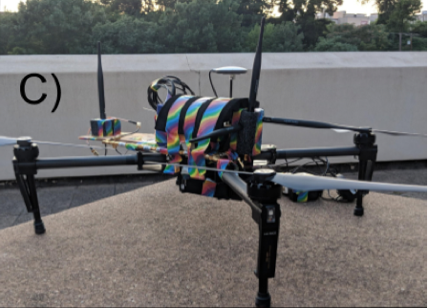
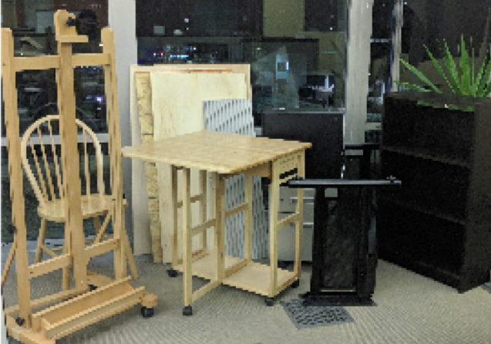


System Implementation
CSE891 | On the Feasibility of Wi-Fi Based Material Sensing
The researchers implemented IntuWition using four Wi-Fi cards, one for transmission and three for receiving on the Intel 5300AGN card. The overall weight of their sensing system is 439g,
The researchers implemented IntuWition's algorithms in MATLAB/C++ and in cloud track location at the rate of 8 Hz and sense materials at 2 Hz.
All their experiments were in indoor/outdoor multipath-rich settings (walls, furniture etc.)
The researchers trained and tested the system on completely different subsets of materials. The material included copper, aluminum, birch, plywood, maple.
They also recruited ten human volunteers of different body types, with half of their testing performed in summer clothing and half of it performed in a winter clothing.
Notes:
1. which can be significantly reduced in future chips. They are using three Wi-Fi cards for receiver because the first port had a consistently higher receive gain on average when compared to the other ports (a peculiarity of the chip).
2. The main bottleneck in ensuring faster, real-time analysis is the amount of time it takes to sweep through all available Wi-Fi channels in the ISM band. In its current state, a full frequency sweep for each receiver radio results in, at most, a file 18.9kB.

Slide 10
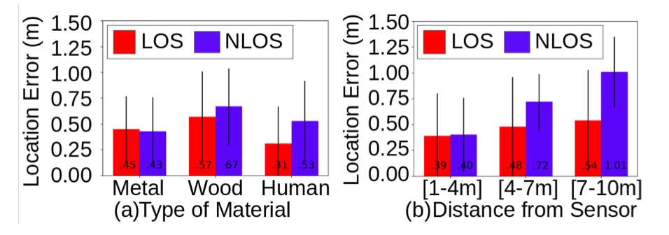
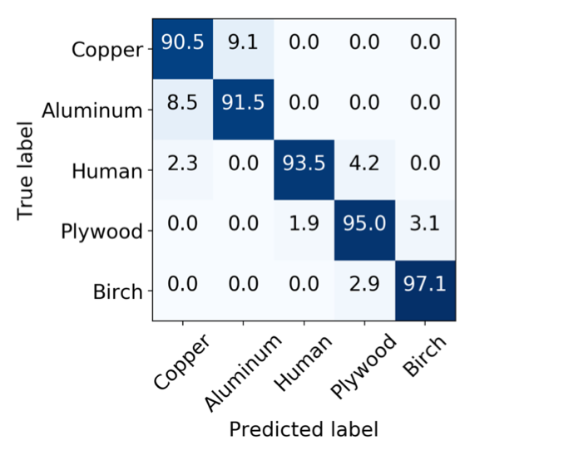
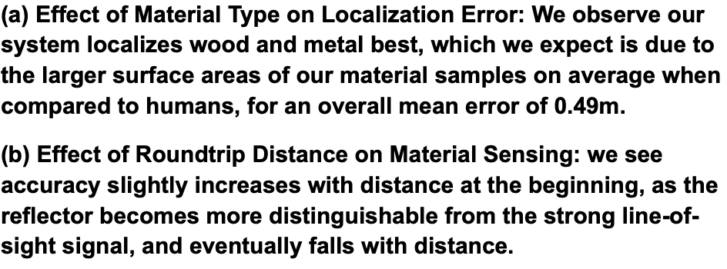
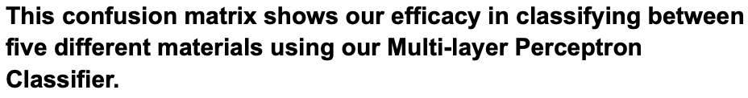
Results
CSE891 | On the Feasibility of Wi-Fi Based Material Sensing

Slide 11
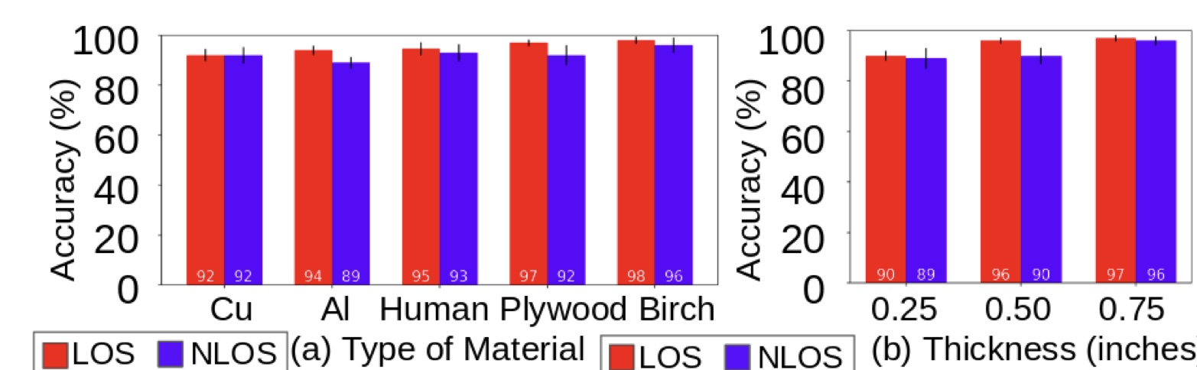
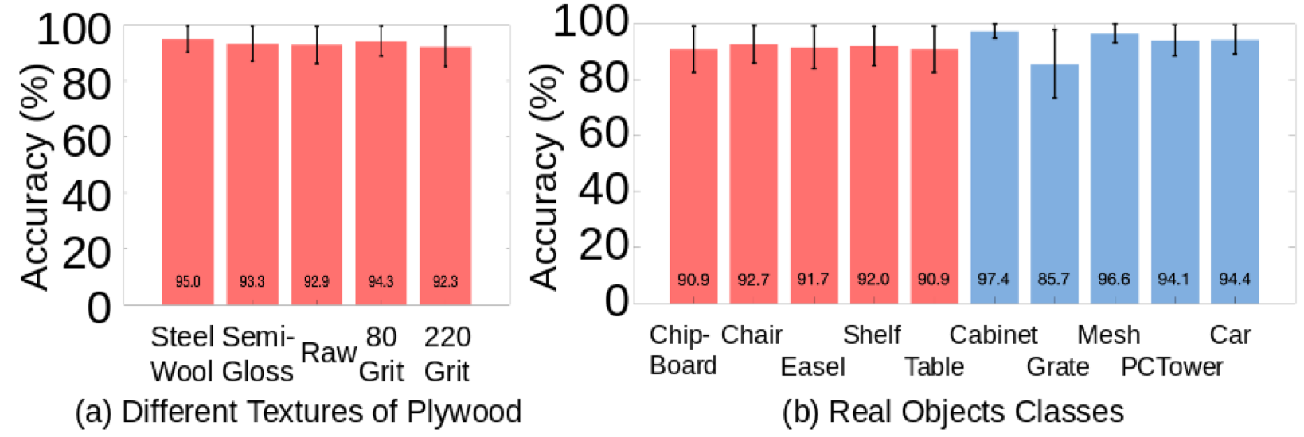
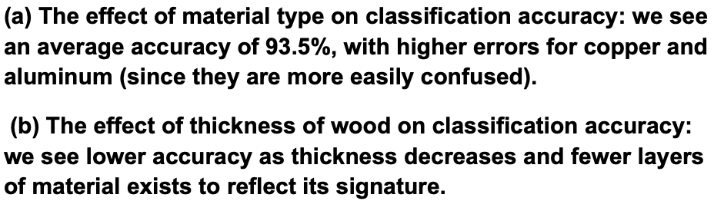
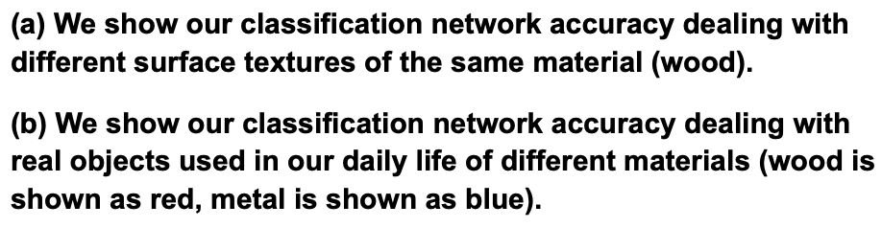
Results
CSE891 | On the Feasibility of Wi-Fi Based Material Sensing

Slide 12
Questions
CSE891 | On the Feasibility of Wi-Fi Based Material Sensing
?
?
?
?
?
?
?
?
?
?

